Slide 1
Making Big Data Open in Edges : A Resource-Efficient Blockchain-based Approach
Making Big Data Open in Edges : A Resource-Efficient Blockchain-based Approach
Akhil Murali
Class no: 06 S7 BTECH CSE
15/11/2018
Dept. of CSE, MACE Kothamangalam
‹#›

Slide 2
Making Big Data Open in Edges : A Resource-Efficient Blockchain-based Approach
CONTENTS
Introduction
Edge Computing
Blockchain
Framework Design
Proof of Collaboration Consensus Mechanism
15/11/2018
Dept. of CSE, MACE Kothamangalam
‹#›
Notes:
‹#›

Slide 3
Making Big Data Open in Edges : A Resource-Efficient Blockchain-based Approach
CONTENTS(Contd...)
Transaction Offloading
Blockchain Network Optimization
Experiment
Conclusion
References
15/11/2018
Dept. of CSE, MACE Kothamangalam
‹#›
Notes:
‹#›

Slide 4
Making Big Data Open in Edges : A Resource-Efficient Blockchain-based Approach
INTRODUCTION(contd..)
Edge Computing
Computation near the source of data
Why Edge computing
Latency
Bandwidth
Security and Privacy
15/11/2018
Dept. of CSE, MACE Kothamangalam
‹#›

Slide 5
Making Big Data Open in Edges : A Resource-Efficient Blockchain-based Approach
INTRODUCTION(contd..)
Constraints on Edge computing
Heterogeneous
Resource constraint
Non Cooperation among Edge device
Centralized trusted third party
Credit scores to select more reliable participants
15/11/2018
Dept. of CSE, MACE Kothamangalam
‹#›

Slide 6
Making Big Data Open in Edges : A Resource-Efficient Blockchain-based Approach
INTRODUCTION(contd..)
Blockchain
Peer to peer
Append-only ledger
Participants interact without a trusted third party.
15/11/2018
Dept. of CSE, MACE Kothamangalam
‹#›

Slide 7
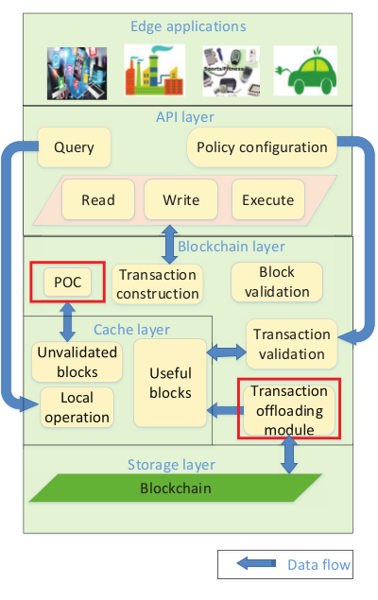
Making Big Data Open in Edges : A Resource-Efficient Blockchain-based Approach
Framework Design
Courtesy : https://ieeexplore.ieee.org/document/8422561/
15/11/2018
Dept. of CSE, MACE Kothamangalam
‹#›
Notes:
1)Read, write, and execute operations abstract transaction construction in the blockchain layer
2)Policy configuration is designed to set the operation permission to local data for other edge devices.
3)Query operation can query operation record of other edge devices on local data, where the latest opera-
tions of local data are stored in the local operation
module in cache layer.

Slide 8
Making Big Data Open in Edges : A Resource-Efficient Blockchain-based Approach
Green Consensus Mechanism
Common Consensus Mechanism
Public blockchain
consortium blockchain
Proof Of Work
Proof of Stake
PBFT
15/11/2018
Dept. of CSE, MACE Kothamangalam
‹#›

Slide 9

Making Big Data Open in Edges : A Resource-Efficient Blockchain-based Approach
Green Consensus Mechanism
Proof-of-Collaboration mechanism
Introduces Collaboration Credit
Collaboration Fee
15/11/2018
Dept. of CSE, MACE Kothamangalam
‹#›
Notes:
“Participants contribute to the big data sharing so that they can also benefit from other participants’ collaboration”
n=no of edge devices
h=Predefind threshould throuhput
h’=Average throughput of the entire network for last 100 blocks
framework will decrease F to encourage collaboration
when the recent throughput is lower than pre-defined
threshold, or increase F to reduce network overload when
the throughput is higher than defined.

Slide 10
Making Big Data Open in Edges : A Resource-Efficient Blockchain-based Approach
Green Consensus Mechanism(Contd..)
CC can be earned in 2 ways:
By adding a new block to the blockchain
From the transactions carried by the block
15/11/2018
Dept. of CSE, MACE Kothamangalam
‹#›
Notes:
Collaborattion fee can prevent the selfish application requesting data without sharing their own data

Slide 11
Making Big Data Open in Edges : A Resource-Efficient Blockchain-based Approach
Green Consensus Mechanism(Contd..)
Rule 1 : Dynamic Difficulty
SHA256(SHA256( h.n )) < CC × P × target
Rule 2 : Winner initialization
The block proposer pays when constructing new block
Rule 3 : Partial Competition
P ∈ [L, R] ,
where L = n/Θ and R=3L
15/11/2018
Dept. of CSE, MACE Kothamangalam
‹#›
Notes:
The proposal has the following three core rules, underpinned by CC and P , to guarantee itself a green blockchain
Θ=0.75
A higher Θin Eq. (4) makes more in-tense
competition, and a lower Θ decreases the security of the
blockchain. The typical value of verT heta is 0.75 .

Slide 12
Making Big Data Open in Edges : A Resource-Efficient Blockchain-based Approach
Green Consensus Mechanism(Contd..)
The power expectation of PoW :
E_{pow}=(Target_{Max}/Target)2³²
The Power expectation for PoC ;
E_{poc}=(Target_{max}/CC * P * Target)2³²
Prevents a minor from immediately competing
15/11/2018
Dept. of CSE, MACE Kothamangalam
‹#›

Slide 13
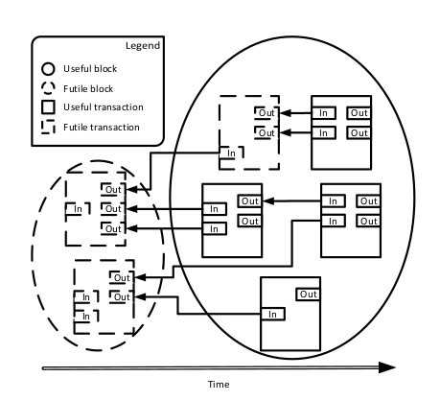
Making Big Data Open in Edges : A Resource-Efficient Blockchain-based Approach
Transaction Offloading
The Structure of Mutual-Reference Transactions are
Courtesy : https://ieeexplore.ieee.org/document/8422561/
15/11/2018
Dept. of CSE, MACE Kothamangalam
‹#›

Slide 14
Making Big Data Open in Edges : A Resource-Efficient Blockchain-based Approach
Transaction Offloading(Contd…)
The transaction references a list of outputs
Check the assets used to pay for new transaction
Protect blockchain against double spending
15/11/2018
Dept. of CSE, MACE Kothamangalam
‹#›
Notes:
The main Idea of validation
“is to check the assets which are used to pay for the new generated transaction”

Slide 15
Making Big Data Open in Edges : A Resource-Efficient Blockchain-based Approach
Transaction Offloading(Contd…)
Futile Transactions
The transaction whose outputs are all referenced
useless for the validation of the new transaction.
15/11/2018
Dept. of CSE, MACE Kothamangalam
‹#›

Slide 16
Making Big Data Open in Edges : A Resource-Efficient Blockchain-based Approach
Transaction Offloading(Contd…)
Design
Novel transaction offloading module
Blockchain network preserve useful blocks
Reduces the storage resource occupation
Works on the basis of FTF Algorithm
15/11/2018
Dept. of CSE, MACE Kothamangalam
‹#›

Slide 17
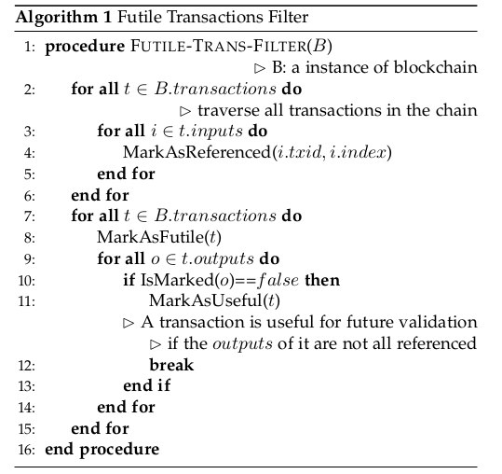
Making Big Data Open in Edges : A Resource-Efficient Blockchain-based Approach
Transaction Offloading(Contd…)
Futile Transaction Filtering Algorithm
15/11/2018
Dept. of CSE, MACE Kothamangalam
‹#›

Slide 18
Making Big Data Open in Edges : A Resource-Efficient Blockchain-based Approach
BLOCKCHAIN NETWORK OPTIMIZATION
Network Utilization Pattern
All transactions and Blocks are propagated
Propagation only after validation
Network is idle while validation
15/11/2018
Dept. of CSE, MACE Kothamangalam
‹#›

Slide 19
Making Big Data Open in Edges : A Resource-Efficient Blockchain-based Approach
BLOCKCHAIN NETWORK OPTIMIZATION(Contd..)
The total Propagation time
T_{max} = _{iϵℐ^V}∑T^{v}_{i} + _{jϵℐ^E}∑T^{c}_{j}
Where
ℐ=longest path in the network
V=set of all participants
E=Set of all connection between participants
15/11/2018
Dept. of CSE, MACE Kothamangalam
‹#›
Notes:
propogation and validation are mutually exclusive

Slide 20
Making Big Data Open in Edges : A Resource-Efficient Blockchain-based Approach
BLOCKCHAIN NETWORK OPTIMIZATION(Contd..)
Waste of Network Resources
Transaction Queue
| Q₁ ∧ Q₂ ∧ · · · ∧ Q_{i} | ≈ | Q_{T} |
Q_{i} The transaction queue of participant i
Q_{T} The transactions Carried by new block
15/11/2018
Dept. of CSE, MACE Kothamangalam
‹#›

Slide 21
Making Big Data Open in Edges : A Resource-Efficient Blockchain-based Approach
BLOCKCHAIN NETWORK OPTIMIZATION(Contd..)
Express Transaction
Participant first propagates it, then performs the validation
Issuer of an E-TX pay the extra “express deposit”
The express deposit will return to the issuer
we use smart contract to support the proposed E-TX
15/11/2018
Dept. of CSE, MACE Kothamangalam
‹#›

Slide 22
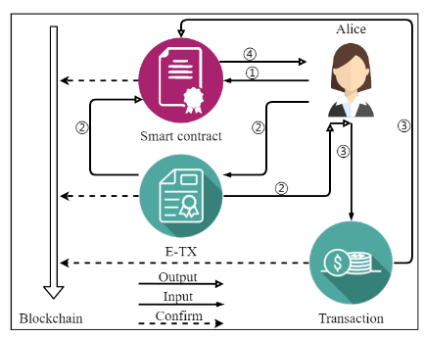
Making Big Data Open in Edges : A Resource-Efficient Blockchain-based Approach
BLOCKCHAIN NETWORK OPTIMIZATION(Contd..)
Courtesy : https://ieeexplore.ieee.org/document/8422561/
15/11/2018
Dept. of CSE, MACE Kothamangalam
‹#›

Slide 23
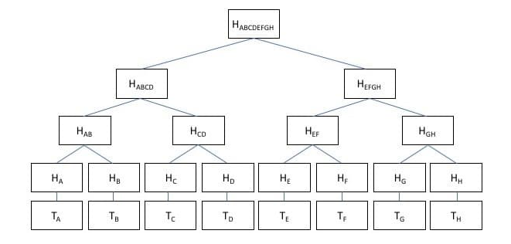
Making Big Data Open in Edges : A Resource-Efficient Blockchain-based Approach
BLOCKCHAIN NETWORK OPTIMIZATION(Contd..)
Hollow Blocks
Merkle Tree
courtesy:https://www.mycryptopedia.com/merkle-tree-merkle-root-explained/
15/11/2018
Dept. of CSE, MACE Kothamangalam
‹#›

Slide 24
Making Big Data Open in Edges : A Resource-Efficient Blockchain-based Approach
BLOCKCHAIN NETWORK OPTIMIZATION(Contd..)
Redundancy Reduction
Hollow Block =
Block header + hash list of Transactions
2 Layer Merkel Tree
Miners can download the missing ones
15/11/2018
Dept. of CSE, MACE Kothamangalam
‹#›

Slide 25
Making Big Data Open in Edges : A Resource-Efficient Blockchain-based Approach
Experiment
Experimental Setup
conducted on 16 RaspberryPi 2 model B with a 900MHz quad-core ARM Cortex-A7 CPU
Core | Power (W) | Hash Rate (MH/s) | A | B | C
0 | 1.2075 | 0 | 0 | 0 | 0
1 | 1.5225 | 0.133 | 2 | 4 | 6
2 | 1.785 | 0.266 | 6 | 4 | 2
3 | 1.995 | 0.414 | 6 | 4 | 2
4 | 2.2575 | 0.554 | 2 | 4 | 6
15/11/2018
Dept. of CSE, MACE Kothamangalam
‹#›

Slide 26
Making Big Data Open in Edges : A Resource-Efficient Blockchain-based Approach
Experiment(Contd..)
Experimental Setup
The data used for experiment is randomly generated.
Every transaction has five inputs and outputs,
Number of transactions per blockτ ∼ U (50, 1000)
15/11/2018
Dept. of CSE, MACE Kothamangalam
‹#›

Slide 27
Making Big Data Open in Edges : A Resource-Efficient Blockchain-based Approach
Experiment(Contd..)
Experiment Results
PoC reduces at most 90% computational resources
Throughput of blockchain with E-TX is 17% higher
Hollow block enhances the throughput to 23% higher
15/11/2018
Dept. of CSE, MACE Kothamangalam
‹#›

Slide 28
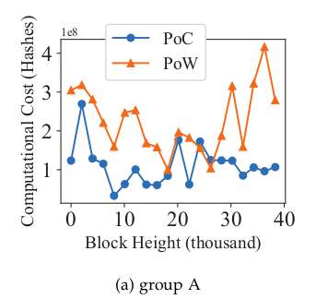
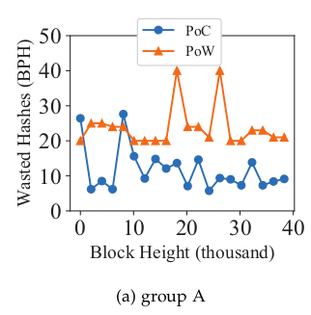
Making Big Data Open in Edges : A Resource-Efficient Blockchain-based Approach
Experiment(Contd..)
Comparison of computational cost
Comparison of wasted hashes
Courtesy : https://ieeexplore.ieee.org/document/8422561/
15/11/2018
Dept. of CSE, MACE Kothamangalam
‹#›

Slide 29
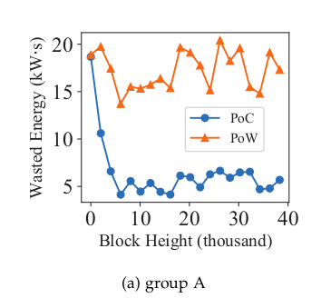
Making Big Data Open in Edges : A Resource-Efficient Blockchain-based Approach
Experiment(Contd..)
Comparison of Wasted Energy
Courtesy : https://ieeexplore.ieee.org/document/8422561/
15/11/2018
Dept. of CSE, MACE Kothamangalam
‹#›

Slide 30
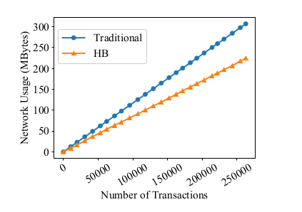
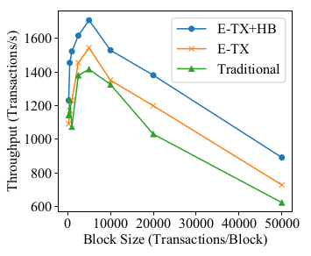
Making Big Data Open in Edges : A Resource-Efficient Blockchain-based Approach
Experiment(Contd..)
Comparison of Network Usage
Comparison of Throughput
Courtesy : https://ieeexplore.ieee.org/document/8422561/
15/11/2018
Dept. of CSE, MACE Kothamangalam
‹#›

Slide 31
Making Big Data Open in Edges : A Resource-Efficient Blockchain-based Approach
CONCLUSION
Employs the blockchain to enable trust big data sharing in edge collaboration
Green PoC consensus mechanism
Futile transaction theory and FTF algorithm
Hollow block and Express transaction
Green and Efficient framework
15/11/2018
Dept. of CSE, MACE Kothamangalam
‹#›

Slide 32
Making Big Data Open in Edges : A Resource-Efficient Blockchain-based Approach
REFERENCES
[1] Chenhan Xu, Kun Wang, Peng Li, Song Guo ,Jiangtao Luo, Baoliu Ye, “Making Big Data Open in Edges: AResource-Efficient Blockchain-based Approach”,DOI 10.1109/TPDS.2018.2871449, IEEE
Transactions on Parallel and Distributed Systems
[2] W. Shi, J. Cao, Q. Zhang, Y. Li, and L. Xu, “Edge computing: Vision and challenges,” IEEE Internet of Things Journal, vol. 3, no. 5, pp.637–646, Oct 2016
[3] Ivanzar. (2017, Aug.) Bitcoin protocol. Bitcoin Wiki. [Online].Available: https://en.bitcoin.it/wiki/Protocol rules
15/11/2018
Dept. of CSE, MACE Kothamangalam
‹#›

Slide 33
Making Big Data Open in Edges : A Resource-Efficient Blockchain-based Approach
REFERENCES
[5]A. Azaria, A. Ekblaw, T. Vieira, and A. Lippman, “Medrec: Using blockchain for medical data access and permission management,” in 2016 2nd International Conference on Open and Big Data (OBD),Aug 2016, pp. 25–30.
[6] A. Stanciu, “Blockchain based distributed control system for edge computing,” in 2017 21st International Conference on Control Systems and Computer Science (CSCS), May 2017, pp. 667–671.
15/11/2018
Dept. of CSE, MACE Kothamangalam
‹#›

Slide 34
Making Big Data Open in Edges : A Resource-Efficient Blockchain-based Approach
THANK YOU
15/11/2018
Dept. of CSE, MACE Kothamangalam
‹#›

